Slide 1
Working Group on Calibration and Validation Land Product Validation subgroup
Introduction and Objectives (2nd day)
Fernando Camacho (EOLAB), Chair
Michael Cosh (USDA), Vice-chair
CEOS LPV Plenary Meeting, Teams – 26/05/2021

Slide 2
Welcome
Speakers
Philippe Goryl | ESA / WGCV
Valentina Boccia | ESA
Bruce Chapman | NASA JPL
Isabel Trigo | IPMA (EUMETSAT LSA SAF)
Roselyne Lacaze | HYGEOS (Copernicus GLS)
Eric Vermote | NASA
Tristan Goulden | BATTELLE (NEON)
Dario Papale | Tuscia U. (ICOS)
Christophe Lerebourg | ACRI (Copernicus GLS)
Joanne Nightingale | NPL (CCVS)
Invited
Ferran Gascón | ESA
Steffen Dransfeld | ESA
Fabrizio Niro | ESA
Jennifer Adams | ESA
Silvia Scifoni | ESA
Georgia Doxani | ESA
Kevin Ruddick | R.Belgian Institute for Natural Sciences
Luke Brown | Southampton U.
Jadunandan Dash | Southampton U.
Juan Pablo Arroyo | NRC-CNRC
Ray Soffer | NRC-CNRC
Benjamin Brede | Wageningen University
Martin Herold | Wageningen University
Ruben Urraca | EC JRC
Nadine Gobron | EC JRC
Christian Lanconelli | EC JRC
Caroline Toté | VITO
Jorge Sanchez | EOLAB
Hank Margolis | NASA
Michael Falkowski | NASA
Notes:
Current focus area leads are responsible for producing a validation protocol for their respective variables describing current methods and good practices within their respective communities. Some of these documents have been produced, and the following are in the pipeline:
Biomass protocol (contribution to CEOS CARBON strategy, CARB-16 and WGCV-19) under internal evaluation. Expected in Q4 2019.
Soil Moisture, Vegetation Indices, Land Cover, Active Fire and Phenology validation protocols are beginning development now. The objective is to have them ready for community review in about two years from now.
LAI protocol needs to be updated to cover new in-situ tools and good practices for high resolution products. The protocol document can also be updated to incorporate FAPAR as well. Expected for Q4 2021.
Surface Reflectance protocols need to be written. ESA is developing protocols for fiducial references and product validation under the FRM4Veg project. Similar exercises are being conducted by the Australian government. Moreover, the WGCV IVOS subgroup proposed that validation of surface reflectance to be subject of a new task force or extension of ACIX (IVOS R-2018-1). This is of strategic need also for LPV subgroup as surface reflectance is the input for most of our land products.

Slide 3
Meeting Objectives
The main objective is to review the CEOS LPV action plan and shape the way forward.
Specific objectives are:
Hear reports from CEOS agencies and operational services on product validation,
Hear activity reports from CEOS LPV focus areas,
Discuss the status of good practices validation protocol,
Report on current validation and intercomparison activities,
Hear updates on fiducial reference data collection and ground networks,
Identify relevant actions and recommendations for the WGCV and CEOS WP 2022-2025,
Exchange information and promote synergies among key actors in the land product validation community.

Slide 4
LPV Strategy
LPV Strategy (2019-2022) agreed in Milan 2019 : https://lpvs.gsfc.nasa.gov/LPV_Meetings/LPV_plenary2019.html
Continuous Development of Good Practices Protocols
Improving ground references: data, sites, uncertainties
Promoting validation and intercomparison exercises
Improving LPV communication
Notes:
Current focus area leads are responsible for producing a validation protocol for their respective variables describing current methods and good practices within their respective communities. Some of these documents have been produced, and the following are in the pipeline:
Biomass protocol (contribution to CEOS CARBON strategy, CARB-16 and WGCV-19) under internal evaluation. Expected in Q4 2019.
Soil Moisture, Vegetation Indices, Land Cover, Active Fire and Phenology validation protocols are beginning development now. The objective is to have them ready for community review in about two years from now.
LAI protocol needs to be updated to cover new in-situ tools and good practices for high resolution products. The protocol document can also be updated to incorporate FAPAR as well. Expected for Q4 2021.
Surface Reflectance protocols need to be written. ESA is developing protocols for fiducial references and product validation under the FRM4Veg project. Similar exercises are being conducted by the Australian government. Moreover, the WGCV IVOS subgroup proposed that validation of surface reflectance to be subject of a new task force or extension of ACIX (IVOS R-2018-1). This is of strategic need also for LPV subgroup as surface reflectance is the input for most of our land products.

Slide 5
LPV Action list
10 actions closed

Slide 6
LPV Action list
12 actions in progress

Slide 7
LPV Action list
5 actions TBD

Slide 8
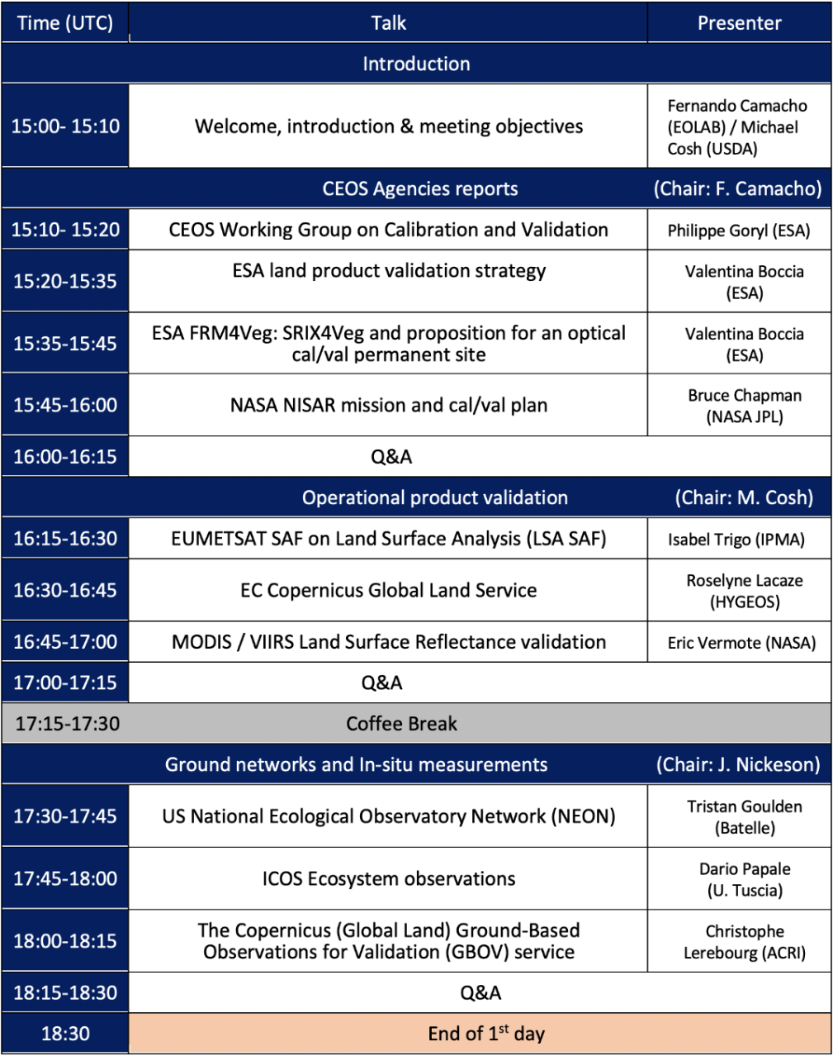
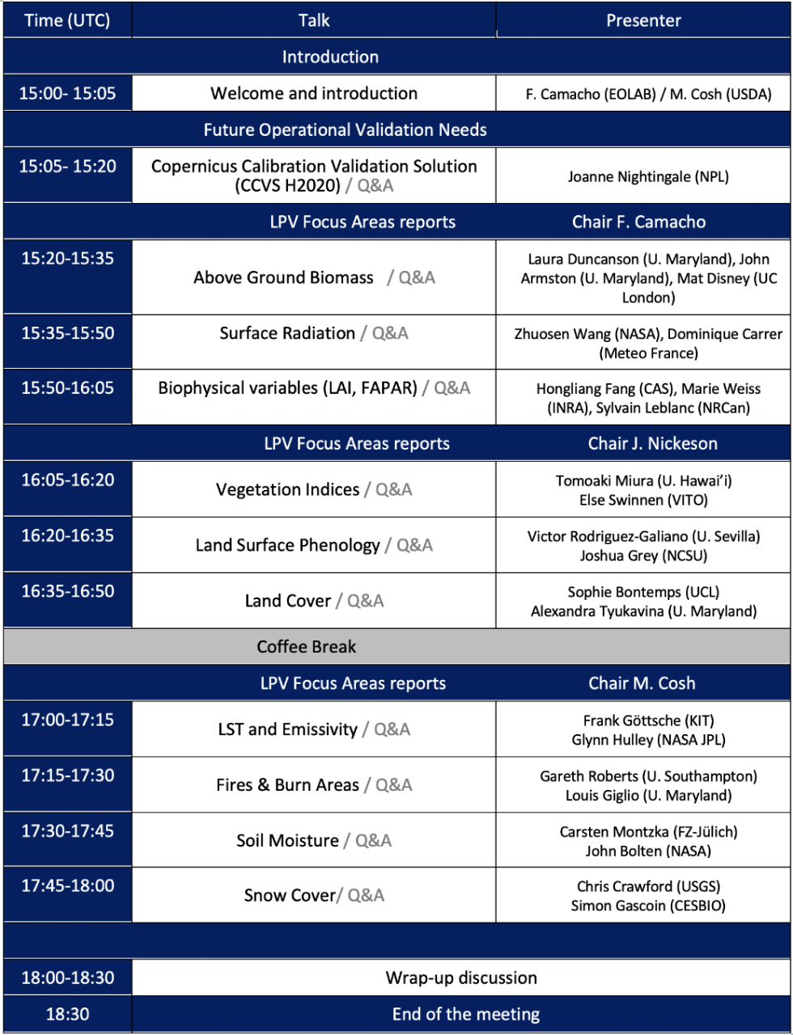
Meeting Agenda
26/05 27/05

